Slide 1


Introduction to Hight Availability

Slide 2

Scan the QR
https://app.sli.do/event/qvzgHQ8Nug5ABqRj5hUJt6
Notes:
Please share your thougths

Slide 3

What is High Availability?
The High Availability system ensures reliability, scalability, and availability for critical production services.
Notes:
What is Performance Testing? Performance testing is a crucial aspect of software testing that focuses on evaluating the speed, responsiveness, and overall efficiency of a software application or system under various conditions. The primary goal is to assess how well the system performs under different workloads and to identify potential bottlenecks or performance issues.
This type of testing helps ensure that the application meets performance requirements, delivers a satisfactory user experience, and can handle the expected load without degradation in performance. Performance testing typically involves activities such as load testing, stress testing, and scalability testing to simulate real-world usage scenarios and assess the system's robustness and stability.
Why is Important?
Risk Mitigation: Performance testing aids in identifying and mitigating potential risks associated with system performance, providing confidence in the application's ability to handle varying workloads in real-world scenarios.
User Experience Assurance: Performance testing helps ensure that the software application delivers a seamless and responsive user experience, meeting user expectations for speed and reliability.
Identifying Bottlenecks: By simulating various levels of user loads, performance testing helps identify potential bottlenecks and weaknesses in the system, enabling proactive optimization before deployment.
Scalability Assessment: It assesses the system's scalability by testing its ability to handle increasing loads, helping organizations plan for future growth and ensuring the system's capacity aligns with business needs.

Slide 4
01
Minimize Downtime
02
Ensure Reliability
03
Improve Fault Tolerance
04
Enhance Scalability
Objectives of
High Availability
05
Automate Failover and Recovery
06
Maintain Data Integrity
07
Optimize Performance
08
Provide Disaster Recovery
09
Ensure Compliance and Security

Slide 5
Some industries where the High Availability Systems are present
Financial Services
Cloud Services
Transportation
Retail and Point Sales
E-commerce
Government Services
Energy
Hospitality
Healthcare
Manufacturing
Online Gaming
Logistics and Supply chain
Telecommunications
Media and Entertainment
Education
Many more….

Slide 6





































Where does the HA Systems are present?...
Notes:
What is Performance Testing? Performance testing is a crucial aspect of software testing that focuses on evaluating the speed, responsiveness, and overall efficiency of a software application or system under various conditions. The primary goal is to assess how well the system performs under different workloads and to identify potential bottlenecks or performance issues.
This type of testing helps ensure that the application meets performance requirements, delivers a satisfactory user experience, and can handle the expected load without degradation in performance. Performance testing typically involves activities such as load testing, stress testing, and scalability testing to simulate real-world usage scenarios and assess the system's robustness and stability.
Why is Important?
Risk Mitigation: Performance testing aids in identifying and mitigating potential risks associated with system performance, providing confidence in the application's ability to handle varying workloads in real-world scenarios.
User Experience Assurance: Performance testing helps ensure that the software application delivers a seamless and responsive user experience, meeting user expectations for speed and reliability.
Identifying Bottlenecks: By simulating various levels of user loads, performance testing helps identify potential bottlenecks and weaknesses in the system, enabling proactive optimization before deployment.
Scalability Assessment: It assesses the system's scalability by testing its ability to handle increasing loads, helping organizations plan for future growth and ensuring the system's capacity aligns with business needs.

Slide 7
High Availability Systems can achieve just 99% of coverage
Hardware Failures
Software Bugs
Human Error
Network Issues
Natural Disasters
Power Outages
Maintenance and Upgrades
Security Threats
Etc.
Coverage 99%
Inherent limitations 1%

Slide 8
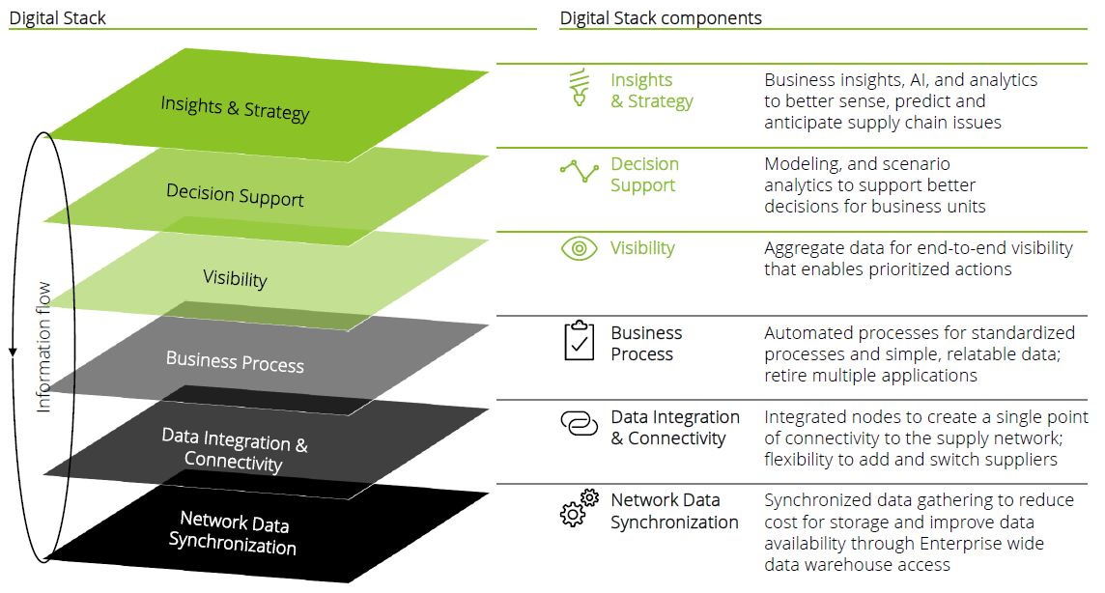
Components of HA
Component
Description
Multiple Servers
Multiple Power supplies
Network interfaces
Redundant Hardware
Automatic Failover
Manual Failover
Load Balancer
Resilience Mechanism
Data Protection
Data Replication
Backup and Recovery
High Availability system
Monitoring and Management
Monitoring system
Alerting System
Geographic Redundancy
Multiple Data Centers
Global Load Balancing

Slide 9





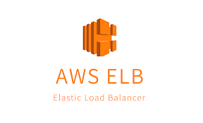






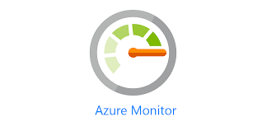

Some popular services for HA available in the market
Notes:
What is Performance Testing? Performance testing is a crucial aspect of software testing that focuses on evaluating the speed, responsiveness, and overall efficiency of a software application or system under various conditions. The primary goal is to assess how well the system performs under different workloads and to identify potential bottlenecks or performance issues.
This type of testing helps ensure that the application meets performance requirements, delivers a satisfactory user experience, and can handle the expected load without degradation in performance. Performance testing typically involves activities such as load testing, stress testing, and scalability testing to simulate real-world usage scenarios and assess the system's robustness and stability.
Why is Important?
Risk Mitigation: Performance testing aids in identifying and mitigating potential risks associated with system performance, providing confidence in the application's ability to handle varying workloads in real-world scenarios.
User Experience Assurance: Performance testing helps ensure that the software application delivers a seamless and responsive user experience, meeting user expectations for speed and reliability.
Identifying Bottlenecks: By simulating various levels of user loads, performance testing helps identify potential bottlenecks and weaknesses in the system, enabling proactive optimization before deployment.
Scalability Assessment: It assesses the system's scalability by testing its ability to handle increasing loads, helping organizations plan for future growth and ensuring the system's capacity aligns with business needs.

Slide 10
Scan the QR
Notes:
Share the biuggest challenges for HA

Slide 11
Active vs Passive Server Introduction

Slide 12


What is Active and Passive Server?
This multi-server strategy minimizes downtime, balances loads, and ensures seamless process.
Notes:
What is Performance Testing? Performance testing is a crucial aspect of software testing that focuses on evaluating the speed, responsiveness, and overall efficiency of a software application or system under various conditions. The primary goal is to assess how well the system performs under different workloads and to identify potential bottlenecks or performance issues.
This type of testing helps ensure that the application meets performance requirements, delivers a satisfactory user experience, and can handle the expected load without degradation in performance. Performance testing typically involves activities such as load testing, stress testing, and scalability testing to simulate real-world usage scenarios and assess the system's robustness and stability.
Why is Important?
Risk Mitigation: Performance testing aids in identifying and mitigating potential risks associated with system performance, providing confidence in the application's ability to handle varying workloads in real-world scenarios.
User Experience Assurance: Performance testing helps ensure that the software application delivers a seamless and responsive user experience, meeting user expectations for speed and reliability.
Identifying Bottlenecks: By simulating various levels of user loads, performance testing helps identify potential bottlenecks and weaknesses in the system, enabling proactive optimization before deployment.
Scalability Assessment: It assesses the system's scalability by testing its ability to handle increasing loads, helping organizations plan for future growth and ensuring the system's capacity aligns with business needs.

Slide 13
Active Vs Passive Servers
Active server
Passive server
Standby Mode: Not handling requests actively but ready for activation.
Redundancy: Provides a backup in case the active server fails.
No Primary Load: Does not manage the primary workload but can assume it if needed.
Regular Testing: Periodically tested to ensure it can take over when necessary.
Operational: Actively running and managing requests.
Load Handling: Manages the primary workload.
Continuous Monitoring: Regularly monitored to ensure optimal performance.
Optimization: Frequently optimized to maintain efficiency.
Active VS Passive

Slide 14
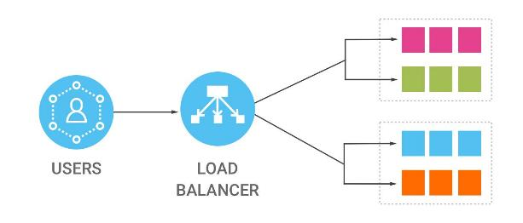
How does it work…
The process of handling transactions efficiently involves load balancing and failover mechanisms. This ensures that user requests are distributed across multiple servers to optimize performance and reliability.
Notes:
What is Performance Testing? Performance testing is a crucial aspect of software testing that focuses on evaluating the speed, responsiveness, and overall efficiency of a software application or system under various conditions. The primary goal is to assess how well the system performs under different workloads and to identify potential bottlenecks or performance issues.
This type of testing helps ensure that the application meets performance requirements, delivers a satisfactory user experience, and can handle the expected load without degradation in performance. Performance testing typically involves activities such as load testing, stress testing, and scalability testing to simulate real-world usage scenarios and assess the system's robustness and stability.
Why is Important?
Risk Mitigation: Performance testing aids in identifying and mitigating potential risks associated with system performance, providing confidence in the application's ability to handle varying workloads in real-world scenarios.
User Experience Assurance: Performance testing helps ensure that the software application delivers a seamless and responsive user experience, meeting user expectations for speed and reliability.
Identifying Bottlenecks: By simulating various levels of user loads, performance testing helps identify potential bottlenecks and weaknesses in the system, enabling proactive optimization before deployment.
Scalability Assessment: It assesses the system's scalability by testing its ability to handle increasing loads, helping organizations plan for future growth and ensuring the system's capacity aligns with business needs.

Slide 15
Types of load balancer systems
This ensures that user requests are distributed across multiple servers to optimize performance and reliability
Hardware balancer
These are dedicated physical devices placed in the data center to manage network traffic.
Software balancer
These are applications that run on standard servers and perform load balancing functions
Load Balancing types
Cloud balancer
These are services offered by cloud providers that manage load balancing as part of their infrastructure.
Notes:
The primary goal of functional testing is to ensure that every component of the software application performs in accordance with the functional requirements and specifications.
Focus Areas:
Input validation
Output generation
Data manipulation
Interface functionality
Application workflow
Some benefits of functional testing includes:
Early Bug Detection: Identifies issues in the early stages, reducing development costs.
Enhanced User Experience: Ensures that the software meets user expectations and requirements.
Increased Reliability: Validates that each function operates as intended, improving overall system reliability.

Slide 16

Common Balancer Algorithms
Round Robin: Distributes requests sequentially among all available servers.
Least Connections: Sends requests to the server with the fewest active connections.
IP Hash: Assigns requests based on the client's IP address, ensuring that requests from the same client go to the same server.
Least Response Time: Sends requests to the server with the lowest current response time.
Source IP Hash: Uses a hash of the source IP address to determine the server to which the request should be sent, maintaining session affinity.
Weighted Round Robin: Assigns a weight to each server and distributes requests based on these weights, with servers of higher capacity receiving more requests.
Weighted Least Connections: Like the least connections algorithm, but also considers a weight assigned to each server, with servers of higher capacity and fewer connections receiving more requests.
Notes:
What is Performance Testing? Performance testing is a crucial aspect of software testing that focuses on evaluating the speed, responsiveness, and overall efficiency of a software application or system under various conditions. The primary goal is to assess how well the system performs under different workloads and to identify potential bottlenecks or performance issues.
This type of testing helps ensure that the application meets performance requirements, delivers a satisfactory user experience, and can handle the expected load without degradation in performance. Performance testing typically involves activities such as load testing, stress testing, and scalability testing to simulate real-world usage scenarios and assess the system's robustness and stability.
Why is Important?
Risk Mitigation: Performance testing aids in identifying and mitigating potential risks associated with system performance, providing confidence in the application's ability to handle varying workloads in real-world scenarios.
User Experience Assurance: Performance testing helps ensure that the software application delivers a seamless and responsive user experience, meeting user expectations for speed and reliability.
Identifying Bottlenecks: By simulating various levels of user loads, performance testing helps identify potential bottlenecks and weaknesses in the system, enabling proactive optimization before deployment.
Scalability Assessment: It assesses the system's scalability by testing its ability to handle increasing loads, helping organizations plan for future growth and ensuring the system's capacity aligns with business needs.

Slide 17







Normal process high traffic
Start again from server: Once the last server in the list is reached, the process starts again from the first server.
Algorithm Selection: Uses Round Robin algorithm to distribute incoming requests.
3
Server Passive
5
Server Active
Server Passive
Load balancer algorithm
Assignation of the request: The load balancer sequentially assigns each incoming request to the next server in the list.
4
Server Active
Load balancer cloud
2
Server Passive Next Ready
1
Server Active
New User
Cloud Balancer: Inspect the load and determine the type (http, https, TCP, etc.)
Traffic Sure Detection: Load balancer detects increase in incoming traffic.
New User Assigned
Notes:
What is Performance Testing? Performance testing is a crucial aspect of software testing that focuses on evaluating the speed, responsiveness, and overall efficiency of a software application or system under various conditions. The primary goal is to assess how well the system performs under different workloads and to identify potential bottlenecks or performance issues.
This type of testing helps ensure that the application meets performance requirements, delivers a satisfactory user experience, and can handle the expected load without degradation in performance. Performance testing typically involves activities such as load testing, stress testing, and scalability testing to simulate real-world usage scenarios and assess the system's robustness and stability.
Why is Important?
Risk Mitigation: Performance testing aids in identifying and mitigating potential risks associated with system performance, providing confidence in the application's ability to handle varying workloads in real-world scenarios.
User Experience Assurance: Performance testing helps ensure that the software application delivers a seamless and responsive user experience, meeting user expectations for speed and reliability.
Identifying Bottlenecks: By simulating various levels of user loads, performance testing helps identify potential bottlenecks and weaknesses in the system, enabling proactive optimization before deployment.
Scalability Assessment: It assesses the system's scalability by testing its ability to handle increasing loads, helping organizations plan for future growth and ensuring the system's capacity aligns with business needs.

Slide 18



Handling server failure
Load B is supported by another server ready
Health Checks
Detection of Failure
Traffic Redirection
Alerting and Logging
Recovery and Re-integration
Server with load B is failing
Load Balancer
Load Balancer
B
B
Passive Server
Passive Server
A
Passive Server
Passive Server
A
Passive Server
Active Server failure
Passive Server
Passive Server
Server Inactive
Active Server
Passive Server
Active Server
Notes:
What is Performance Testing? Performance testing is a crucial aspect of software testing that focuses on evaluating the speed, responsiveness, and overall efficiency of a software application or system under various conditions. The primary goal is to assess how well the system performs under different workloads and to identify potential bottlenecks or performance issues.
This type of testing helps ensure that the application meets performance requirements, delivers a satisfactory user experience, and can handle the expected load without degradation in performance. Performance testing typically involves activities such as load testing, stress testing, and scalability testing to simulate real-world usage scenarios and assess the system's robustness and stability.
Why is Important?
Risk Mitigation: Performance testing aids in identifying and mitigating potential risks associated with system performance, providing confidence in the application's ability to handle varying workloads in real-world scenarios.
User Experience Assurance: Performance testing helps ensure that the software application delivers a seamless and responsive user experience, meeting user expectations for speed and reliability.
Identifying Bottlenecks: By simulating various levels of user loads, performance testing helps identify potential bottlenecks and weaknesses in the system, enabling proactive optimization before deployment.
Scalability Assessment: It assesses the system's scalability by testing its ability to handle increasing loads, helping organizations plan for future growth and ensuring the system's capacity aligns with business needs.

Slide 19



Scalable load balancing - Horizontal
Horizontal: Adding more servers to handle increased load. Provides flexibility to scale out (add more servers) or scale in (remove servers) based on demand.
3
Passive servers are added to the active servers
Active Servers
Passive Servers
Load Balancer
1
2
Load increase with more users
Load balancers distribute traffic across multiple servers, making it easy to add or remove servers as needed.
IMPORTANT: All Servers (passive and active have one module)
Notes:
What is Performance Testing? Performance testing is a crucial aspect of software testing that focuses on evaluating the speed, responsiveness, and overall efficiency of a software application or system under various conditions. The primary goal is to assess how well the system performs under different workloads and to identify potential bottlenecks or performance issues.
This type of testing helps ensure that the application meets performance requirements, delivers a satisfactory user experience, and can handle the expected load without degradation in performance. Performance testing typically involves activities such as load testing, stress testing, and scalability testing to simulate real-world usage scenarios and assess the system's robustness and stability.
Why is Important?
Risk Mitigation: Performance testing aids in identifying and mitigating potential risks associated with system performance, providing confidence in the application's ability to handle varying workloads in real-world scenarios.
User Experience Assurance: Performance testing helps ensure that the software application delivers a seamless and responsive user experience, meeting user expectations for speed and reliability.
Identifying Bottlenecks: By simulating various levels of user loads, performance testing helps identify potential bottlenecks and weaknesses in the system, enabling proactive optimization before deployment.
Scalability Assessment: It assesses the system's scalability by testing its ability to handle increasing loads, helping organizations plan for future growth and ensuring the system's capacity aligns with business needs.

Slide 20
Scalable load balancing - Vertical
2
Load balancers distribute traffic across multiple servers, making it easy to add or remove servers as needed.
Vertical: Increasing the capacity of existing servers (e.g., adding more CPU, memory). Enhances the capacity of individual servers to handle more load.
Active Servers
Load Balancer
1
3
CPU are added to the existing servers
Load increase with more users
Notes:
What is Performance Testing? Performance testing is a crucial aspect of software testing that focuses on evaluating the speed, responsiveness, and overall efficiency of a software application or system under various conditions. The primary goal is to assess how well the system performs under different workloads and to identify potential bottlenecks or performance issues.
This type of testing helps ensure that the application meets performance requirements, delivers a satisfactory user experience, and can handle the expected load without degradation in performance. Performance testing typically involves activities such as load testing, stress testing, and scalability testing to simulate real-world usage scenarios and assess the system's robustness and stability.
Why is Important?
Risk Mitigation: Performance testing aids in identifying and mitigating potential risks associated with system performance, providing confidence in the application's ability to handle varying workloads in real-world scenarios.
User Experience Assurance: Performance testing helps ensure that the software application delivers a seamless and responsive user experience, meeting user expectations for speed and reliability.
Identifying Bottlenecks: By simulating various levels of user loads, performance testing helps identify potential bottlenecks and weaknesses in the system, enabling proactive optimization before deployment.
Scalability Assessment: It assesses the system's scalability by testing its ability to handle increasing loads, helping organizations plan for future growth and ensuring the system's capacity aligns with business needs.

Slide 21
Scalable load balancing system Auto – Scaling
Auto - Scaling: Automatically adding or removing servers based on predefined metrics (e.g., CPU usage, response time). Ensures optimal resource utilization and cost efficiency by scaling resources in real-time
Active Servers
Passive Servers
Load Balancer
2
Load balancers distribute traffic using horizontal and vertical scaling
1
Load increase with more users
3
CPU are added to the existing servers
Notes:
What is Performance Testing? Performance testing is a crucial aspect of software testing that focuses on evaluating the speed, responsiveness, and overall efficiency of a software application or system under various conditions. The primary goal is to assess how well the system performs under different workloads and to identify potential bottlenecks or performance issues.
This type of testing helps ensure that the application meets performance requirements, delivers a satisfactory user experience, and can handle the expected load without degradation in performance. Performance testing typically involves activities such as load testing, stress testing, and scalability testing to simulate real-world usage scenarios and assess the system's robustness and stability.
Why is Important?
Risk Mitigation: Performance testing aids in identifying and mitigating potential risks associated with system performance, providing confidence in the application's ability to handle varying workloads in real-world scenarios.
User Experience Assurance: Performance testing helps ensure that the software application delivers a seamless and responsive user experience, meeting user expectations for speed and reliability.
Identifying Bottlenecks: By simulating various levels of user loads, performance testing helps identify potential bottlenecks and weaknesses in the system, enabling proactive optimization before deployment.
Scalability Assessment: It assesses the system's scalability by testing its ability to handle increasing loads, helping organizations plan for future growth and ensuring the system's capacity aligns with business needs.

Slide 22

Conclusion
High availability ensures system reliability by minimizing down time and efficiently managing the traffic. Load Balancing, combined with horizontal and vertical scaling allows seamless performance. Implementing the right strategies helps maintain optimal service and user experience.
Notes:
What is Performance Testing? Performance testing is a crucial aspect of software testing that focuses on evaluating the speed, responsiveness, and overall efficiency of a software application or system under various conditions. The primary goal is to assess how well the system performs under different workloads and to identify potential bottlenecks or performance issues.
This type of testing helps ensure that the application meets performance requirements, delivers a satisfactory user experience, and can handle the expected load without degradation in performance. Performance testing typically involves activities such as load testing, stress testing, and scalability testing to simulate real-world usage scenarios and assess the system's robustness and stability.
Why is Important?
Risk Mitigation: Performance testing aids in identifying and mitigating potential risks associated with system performance, providing confidence in the application's ability to handle varying workloads in real-world scenarios.
User Experience Assurance: Performance testing helps ensure that the software application delivers a seamless and responsive user experience, meeting user expectations for speed and reliability.
Identifying Bottlenecks: By simulating various levels of user loads, performance testing helps identify potential bottlenecks and weaknesses in the system, enabling proactive optimization before deployment.
Scalability Assessment: It assesses the system's scalability by testing its ability to handle increasing loads, helping organizations plan for future growth and ensuring the system's capacity aligns with business needs.

Slide 23

Thanks!

